Slide 1

Cross-View Action Recognition via Joint Dictionary and Transfer Learning
Deepak Kumar, Chetan Kumar, Ming Shao
{dkumar2, ckumar, mshao}@umassd.edu
Department of Computer and Information Sciences, University of Massachusetts, Dartmouth

Slide 2
Outline
Background
Motivation
Methodology
Experiments
Conclusion

Slide 3
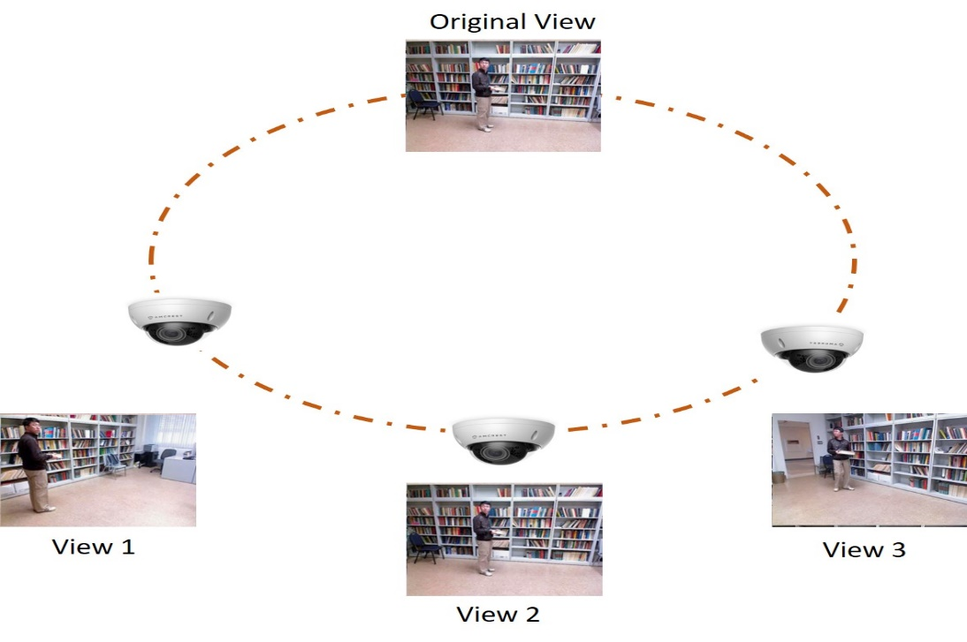
Background
Applications
Video surveillance systems
Human-computer interaction
Ambient assisted living
Entertainment
And more…

Slide 4
Background
Cross-view action recognition
From different views yet robust to view variation
Essential for human computer interaction, video retrieval, especially in activity monitoring in surveillance scenarios
Challenges
Same action looks quite different across views
Action recognition models learned from one view become less discriminative for recognition in another view

Slide 5
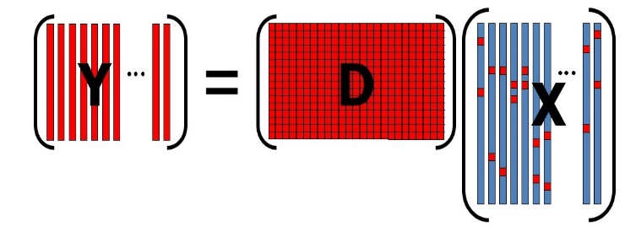
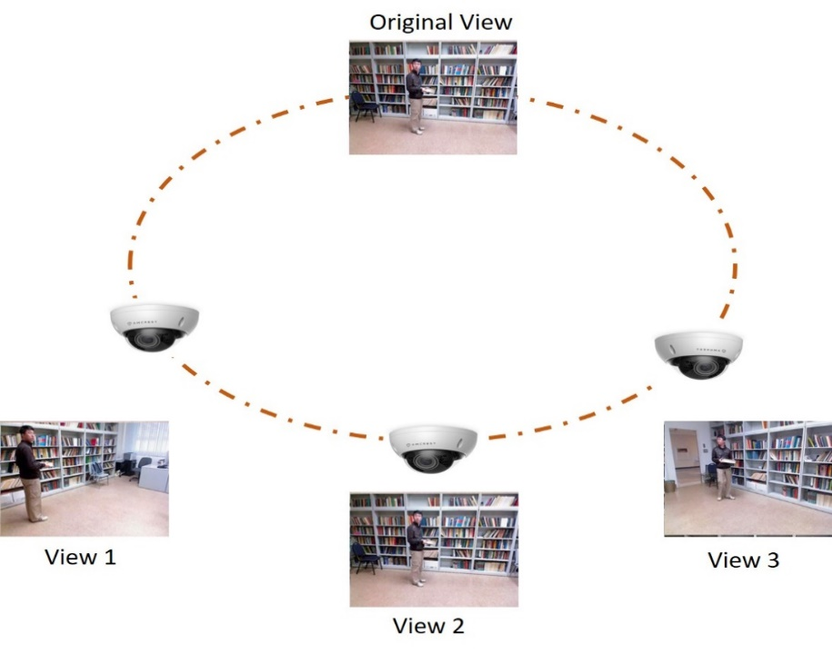
Knowledge Distilling: Dictionary Learning
[J. Wright, TPAMI.2008, Yu Huang 2013]
Signals can be well approximated by linear combination of some basis or dictionary
Designing discriminative features requires new domain knowledge
Learning features from data itself to overcome limitations
However, performance degrades for cross-view action recognition
“what you see” is different in another view “what you recognize”
??
??

Slide 6
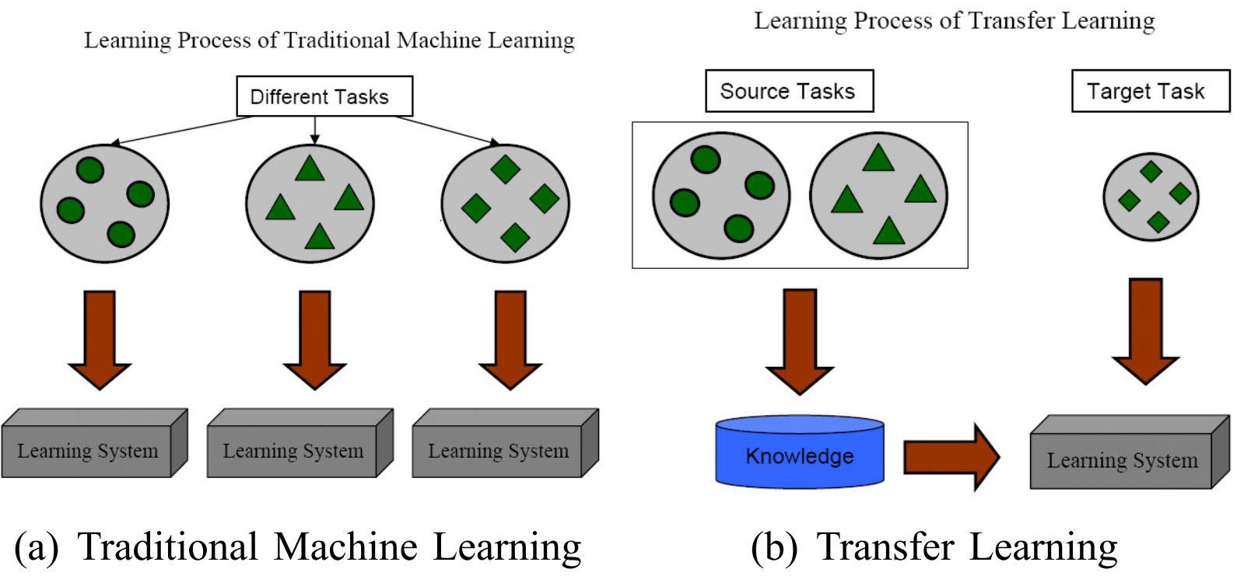
Bridge the Knowledge Gap
ML needs sufficient and dedicated training data. If not, it leads to worse performance
Transfer learning aims to help to improve the learning of target predictive function using the source knowledge
How?? Apply the existing learning model to new or shifted domain. Need model adaptation!!
[Pan et al. , TKDE2009]
Options: Bring source and target into a common subspace to account for distribution divergency or feature space changes

Slide 7
Methodology

Slide 8
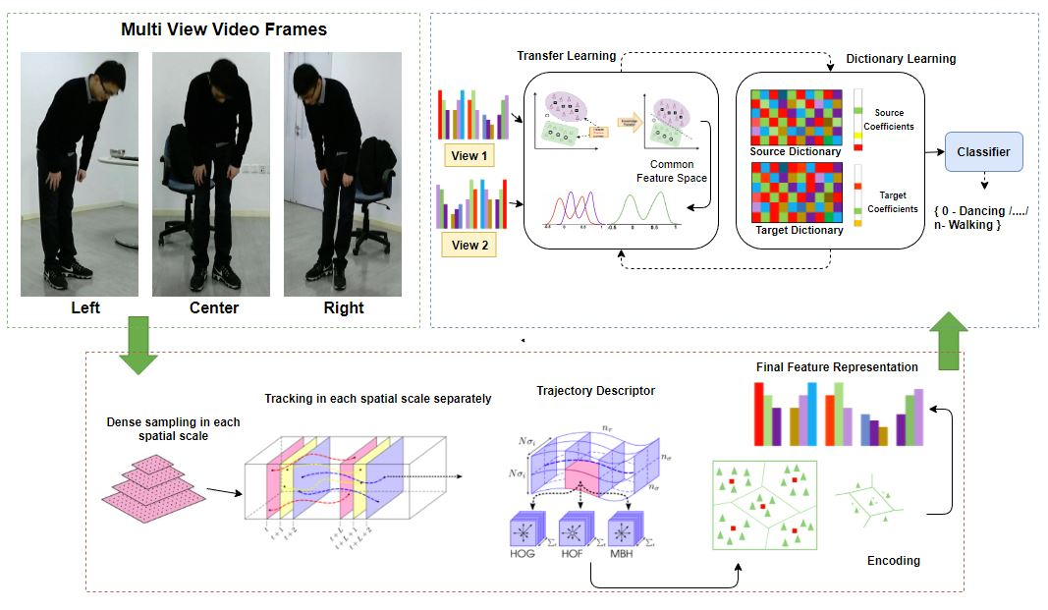
Framework Overview

Slide 9
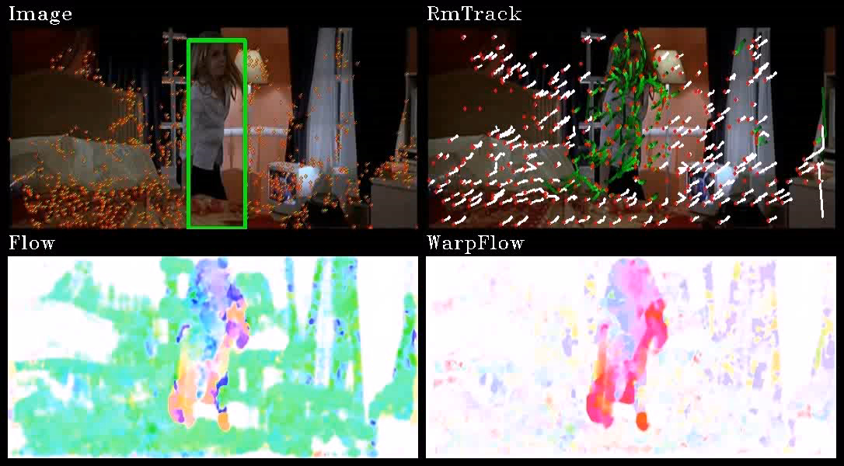
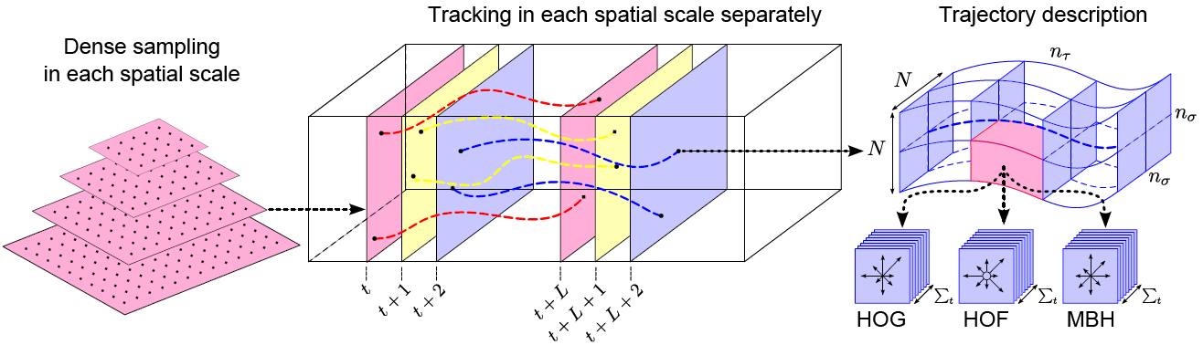
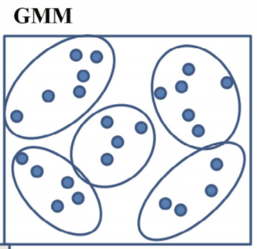
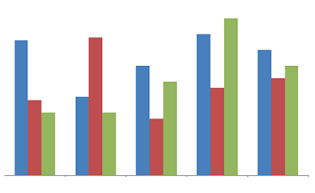
Pipeline of Feature Engineering
Three Major Steps
Feature Extraction and Codebook Generation
Improved Dense Trajectories is used for feature extraction
Fisher Vectors for visual vocabularies
Transfer Learning
Dictionary Learning
Camera motion
Cluttered background and occlusion
Viewpoint and illumination changes
Jointly Learning
GMM
Fisher Vector
[Wang et al. , CVPR2011, Wang et al. 2013]

Slide 10
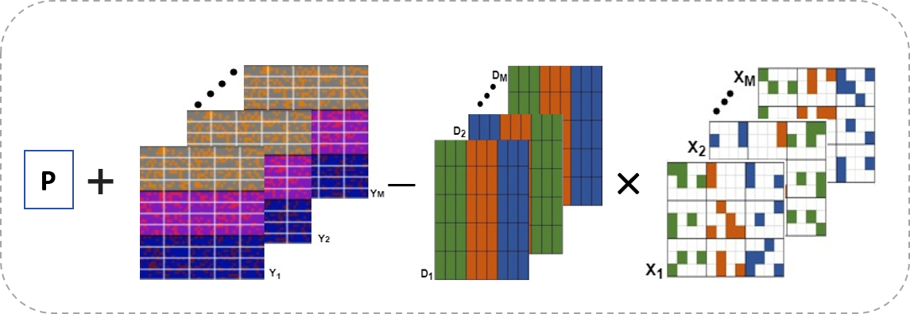
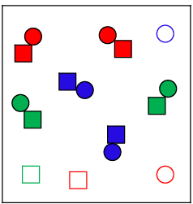
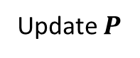

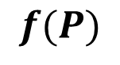
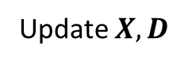
Joint Learning Paradigm
Generic Transfer Learning
Dictionary Learning using Transfer Learning Projection Matrix
Dictionaries {D₁,…,D_{M}} corresponding to different views
Coefficients with each view
+
$$×$$
Update $P$
Update $X,D$
$$f(P)$$
$$λ_{1}g\left(D,X\right)+{λ_{2}||P^{T}Y−DX||}_{F}^{2}$$
Views
Classes
Class1
Generic transfer subspace learning
Fisher criterion
Sparse coding
View1
View2
Class2
Class3
Low-rank dictionary learning
ClassM

Slide 11
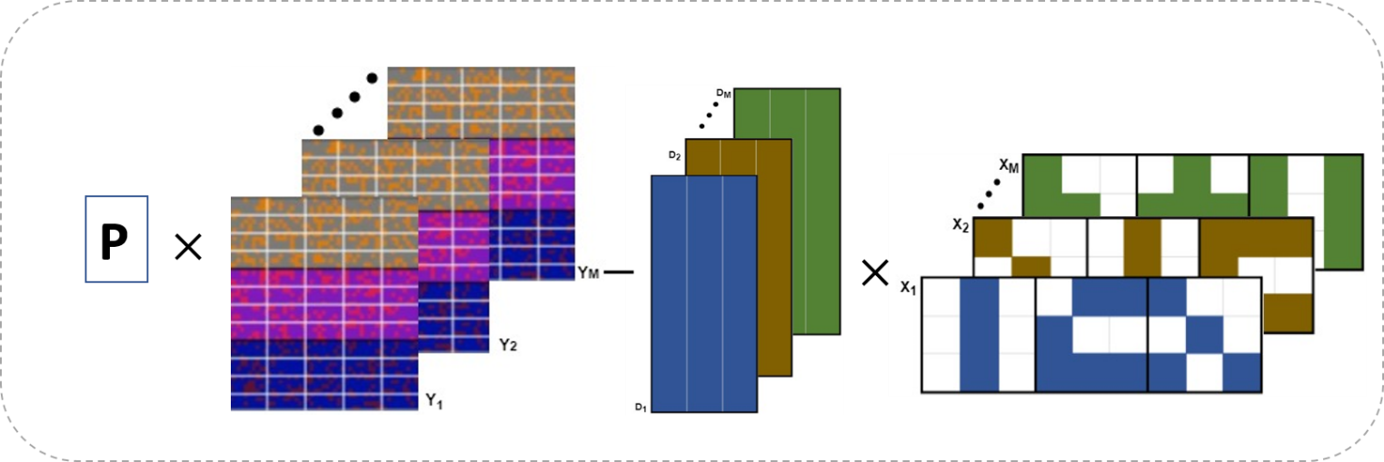
Joint Learning Paradigm
Generic Transfer Learning
Dictionary Learning using Transfer Learning Projection Matrix
Dictionaries {D₁,…,D_{M}} corresponding to different views
Coefficients with each view
+
Update $P$
Update $X,D$
$$f(P)$$
$$λ_{1}g\left(D,X\right)+{λ_{2}||P^{T}Y−DX||}_{F}^{2}$$
Views
Classes
Class1
Generic transfer subspace learning
Fisher criterion
Sparse coding
View1
View2
Class2
Class3
Low-rank dictionary learning
ClassM

Slide 12
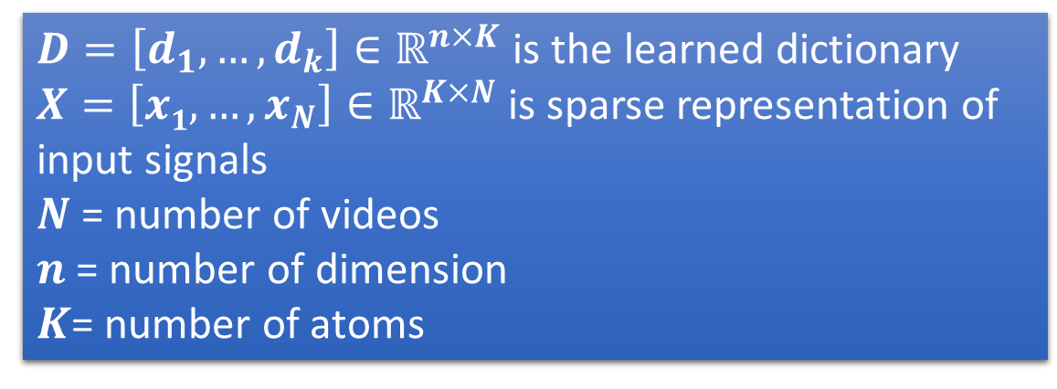
Sparse Coding Revisit
In sparse coding we minimize the following:
The dictionary can be efficiently optimized by K-SVD or K-means
The sparse coding may use OMP or other pursuit methods
Training Samples
$$\left(D,X\right)= arg\min_{D,X}{{||Y−DX||}_{F}^{2}}{ }s.t. ∀i,{||x_{i}||}_{0}≤s$$
Initialize Dictionary
Sparse coding (OMP)
Update Dictionary
$D=\left[d_{1},…,d_{k}\right]∈ℝ^{n×K}$ is the learned dictionary
$X=\left[x1,…,x_{N}\right]∈ℝ^{K×N}$ is sparse representation of input signals
$N$ = number of videos
$n$ = number of dimension
$K$= number of atoms

Slide 13
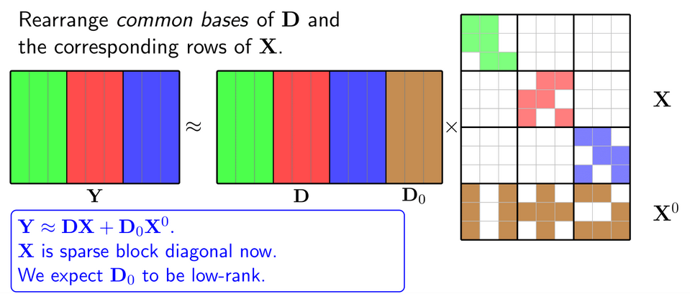
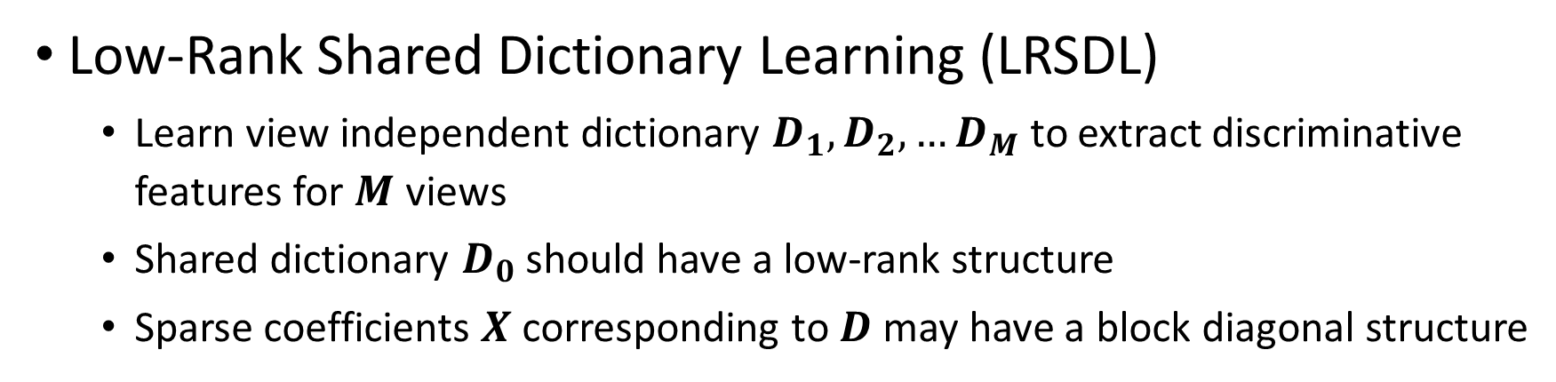
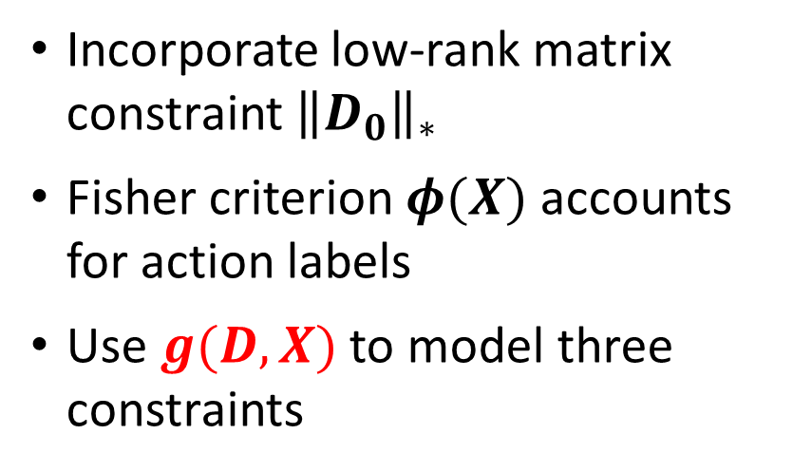
Low-rank Shared Dictionary
Low-Rank Shared Dictionary Learning (LRSDL)
Learn view independent dictionary $D_{1},D_{2},…D_{M}$ to extract discriminative features for $M$ views
Shared dictionary $D_{0}$ should have a low-rank structure
Sparse coefficients $X$ corresponding to $D$ may have a block diagonal structure
Incorporate low-rank matrix constraint ${\left\|D_{0}\right\|}_{∗}$
Fisher criterion $φ(X)$ accounts for action labels
Use $g(D,X)$ to model three constraints
[Y. Xu et al. , IEEE ACCESS, 2017,
T. H. Vu, TIP.2017 ]

Slide 14
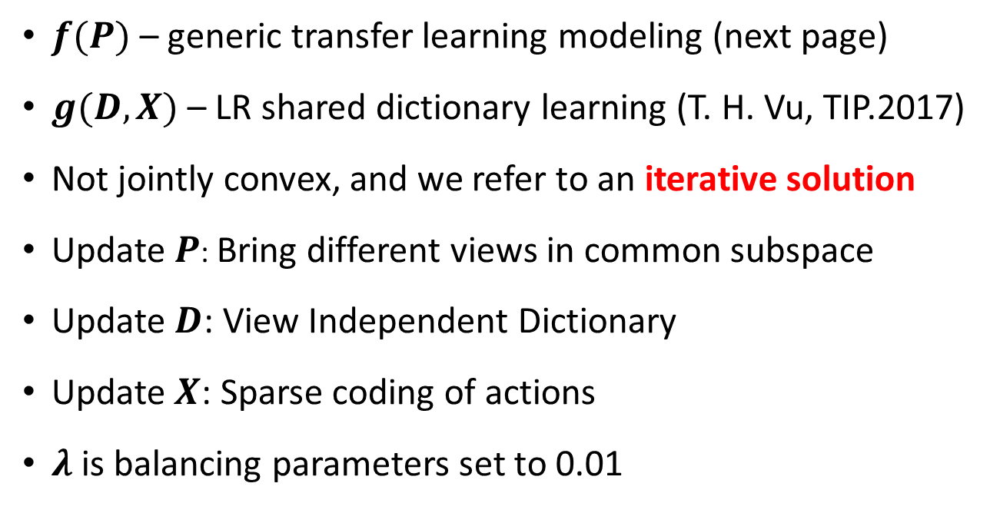
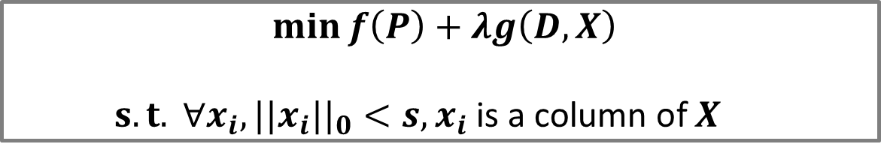
Joint Dictionary and Transfer Learning
$$\min{f\left(P\right)+λg\left(D,X\right)}$$
$s.t. ∀x_{i}, {||x_{i}||}_{0}<s, x_{i}$is a column of $X$
Initialize Projection Matrix P
Initialize Dictionary
$f(P)$ – generic transfer learning modeling (next page)
$g(D,X)$ – LR shared dictionary learning (T. H. Vu, TIP.2017)
Not jointly convex, and we refer to an iterative solution
Update $P$: Bring different views in common subspace
Update $D$: View Independent Dictionary
Update $X$: Sparse coding of actions
$λ$is balancing parameters set to 0.01
Fix D, P, find sparse X
Fix X, P update D
Fix D, X update P
Notes:
Lambda = 0.01

Slide 15
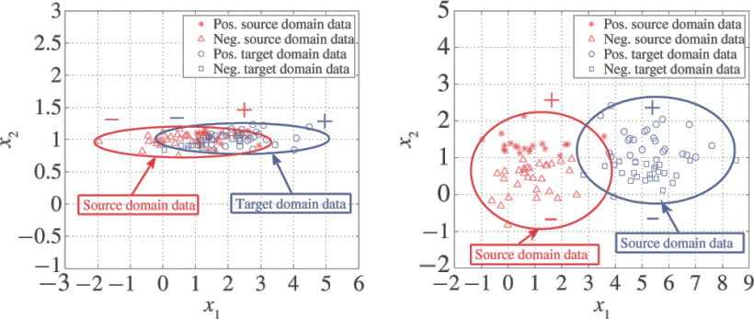
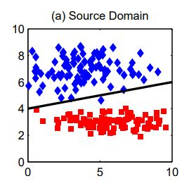
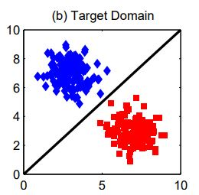
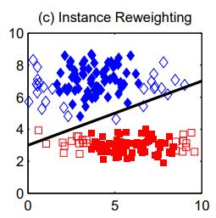
A Glare of Transfer Subspace Learning
Transfer Component Analysis (TCA)
Transfer Joint Matching (TJM)
Jointly perform feature matching and instance reweighting
Joint Distribution Adaptation (JDA)
Preserve structural properties
Match marginal and conditional distribution
Balance Distribution Adaptation (BDA)
Source and target data is labeled
Balance the marginal and conditional distribution
[Long et al. , ICCV2013, Pan et al., TNN2010 ]

Slide 16
Experiments

Slide 17
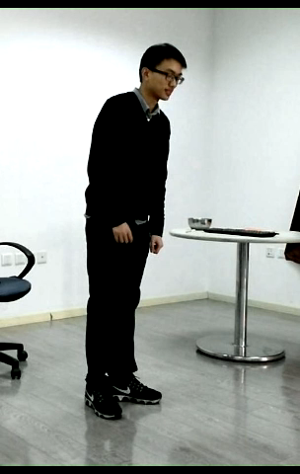
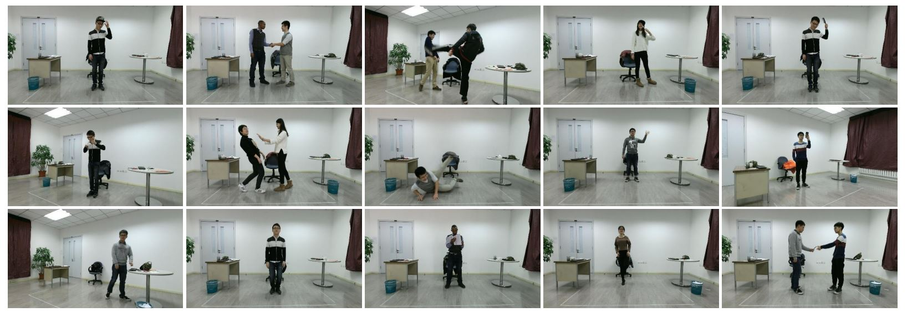
Dataset Pre-processing
PKU-MMD dataset is used for evaluation
Collected from 3 different and fixed angles
Including 51 classes
Data Segmentation
1000+ long action Sequences
Each lasts 3~4 minutes long
20 actions approximately
Video Frame Cropped
Human and object detector

Slide 18
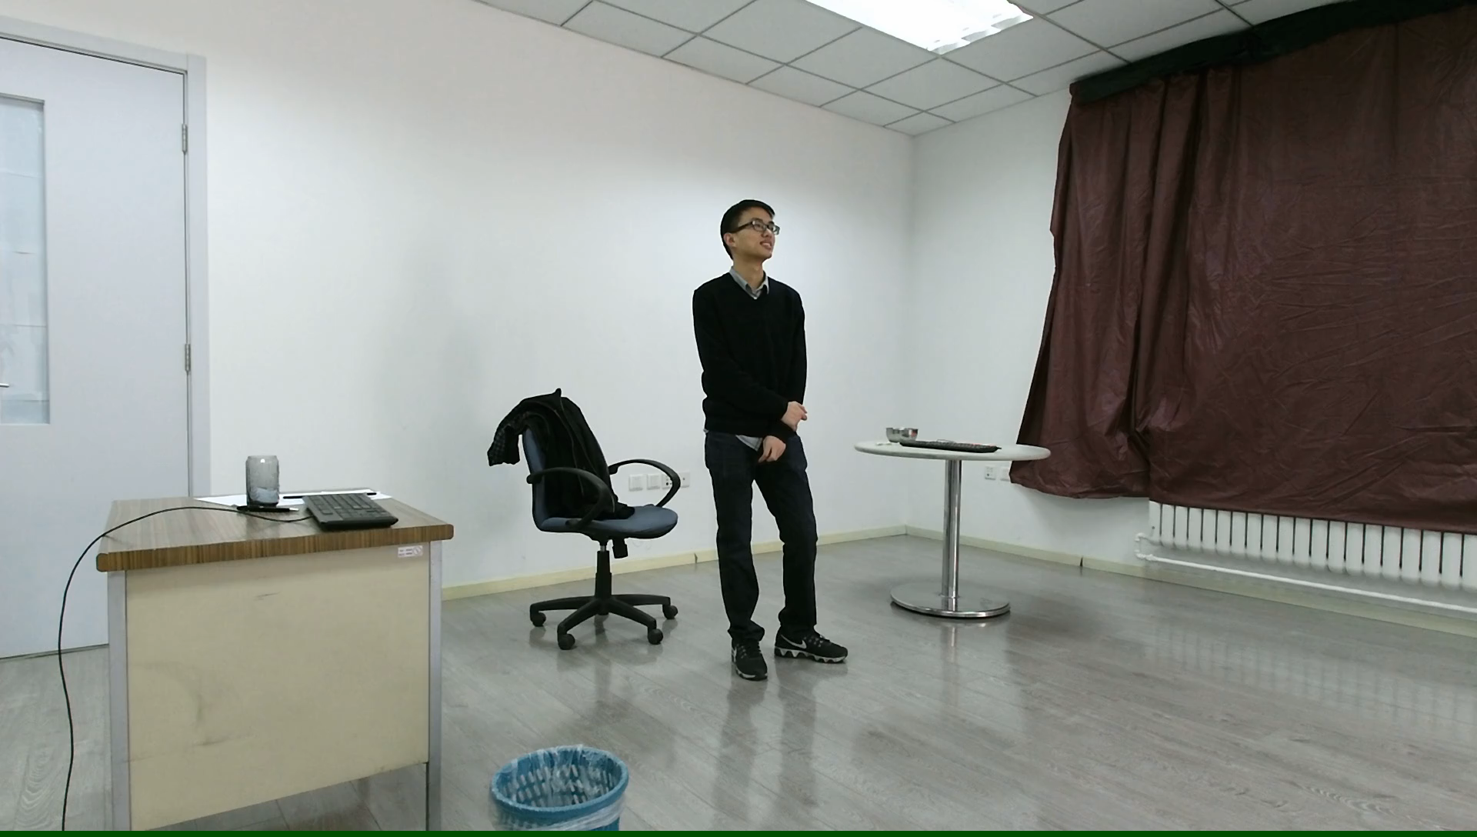
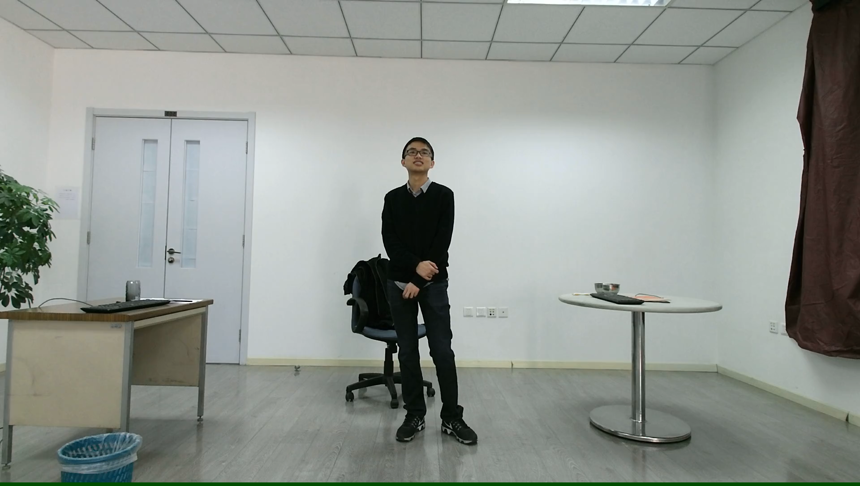
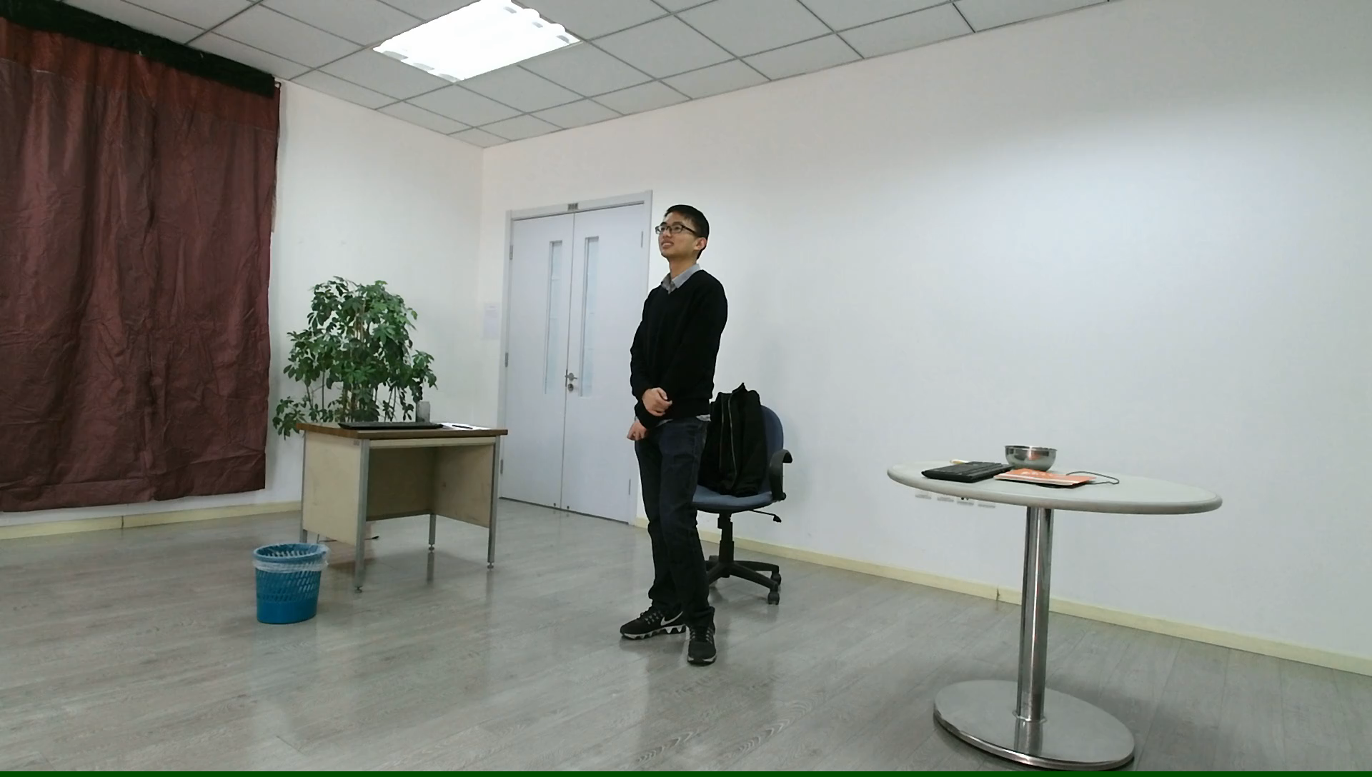
View1
View2
View3

Slide 19
Experiment Setup
Training and Testing Split
Training 85%
Testing 15%
Dimension of Fisher Vector for IDT
IDT: 54528
Dimension Reduction
Principle Component Analysis
Dimension set to 400D

Slide 20
Results
Cross-View Action Recognition without Transfer Learning
Cross-View Action Recognition with Transfer Learning
Cross-View Action Recognition with Dictionary Learning
Cross-View Action Recognition via Joint Dictionary and Transfer Learning

Slide 21
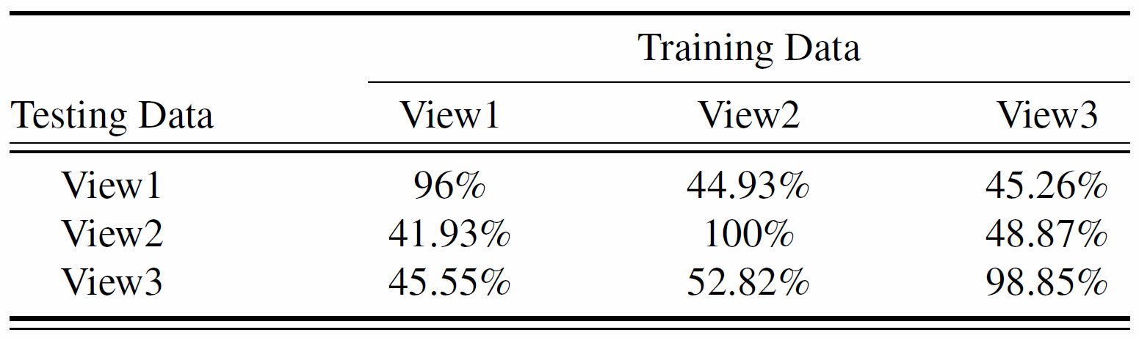
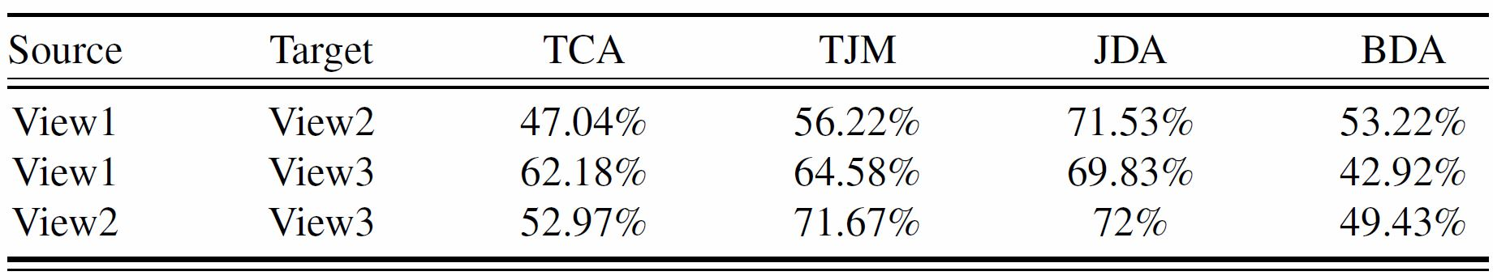
Cross-View Action Recognition w/o and w/ Transfer Learning

Slide 22
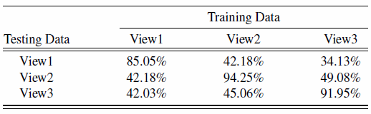
Cross-View Action Recognition with Dictionary Learning

Slide 23
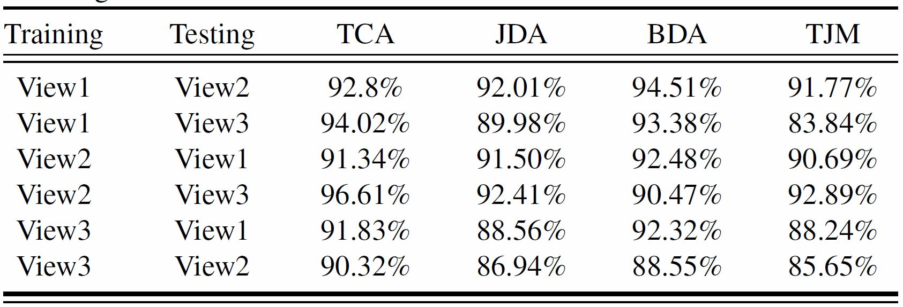
Cross-View Action Recognition via Joint Dictionary and Transfer Learning

Slide 24
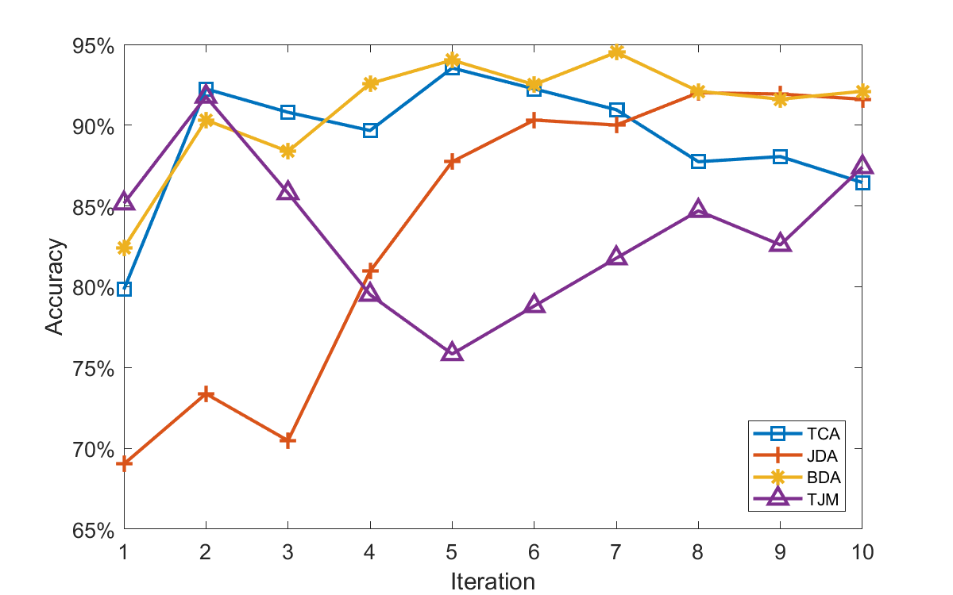
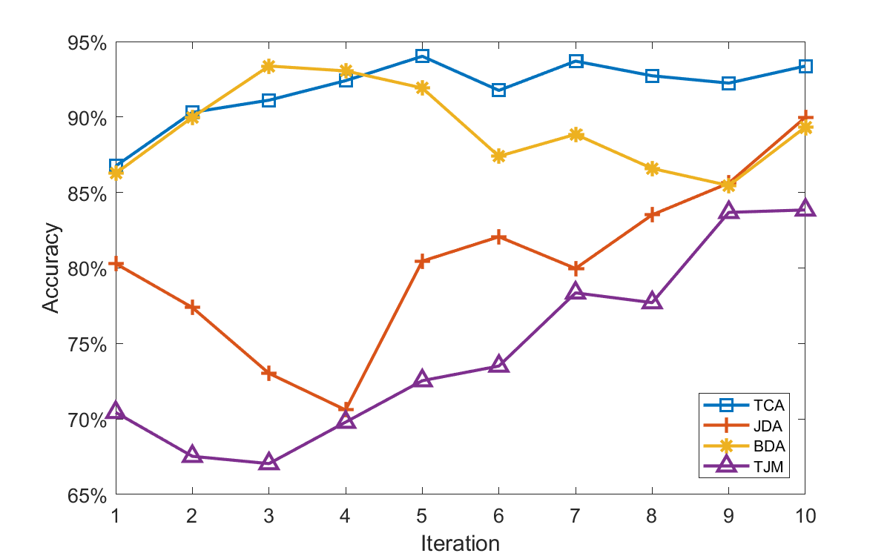
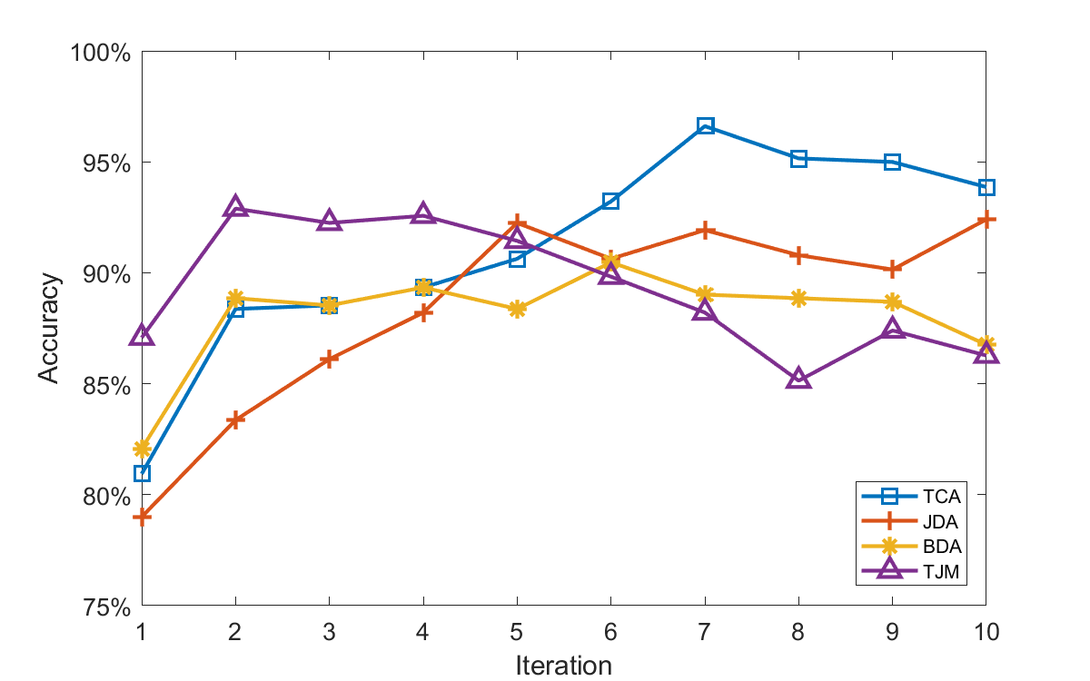
Cross-View Action Recognition via Joint Dictionary and Transfer Learning
View 1- View2
View 1- View3
View 2- View3

Slide 25
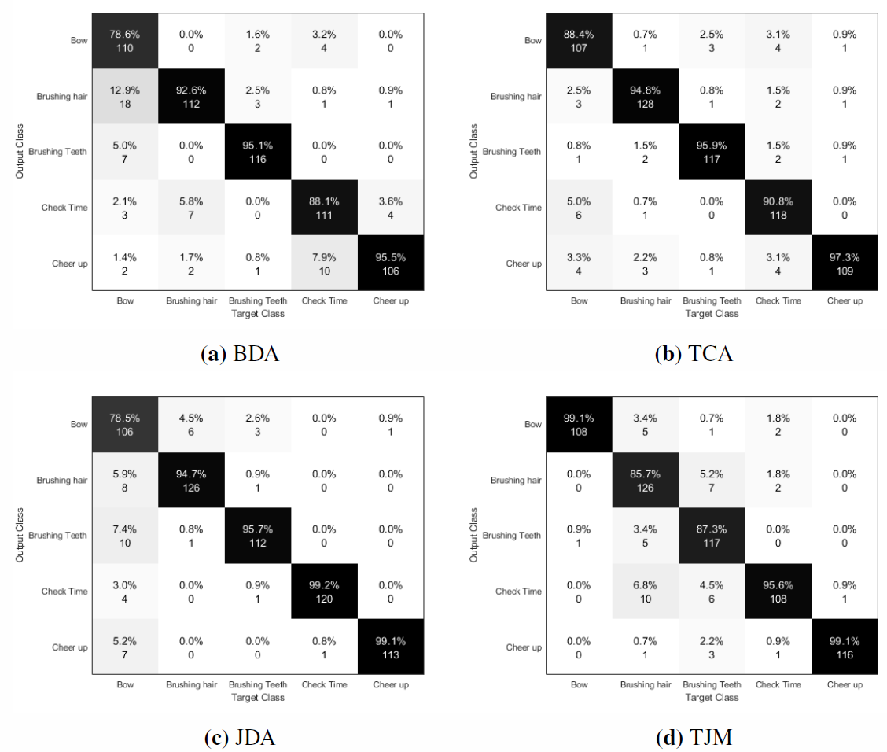
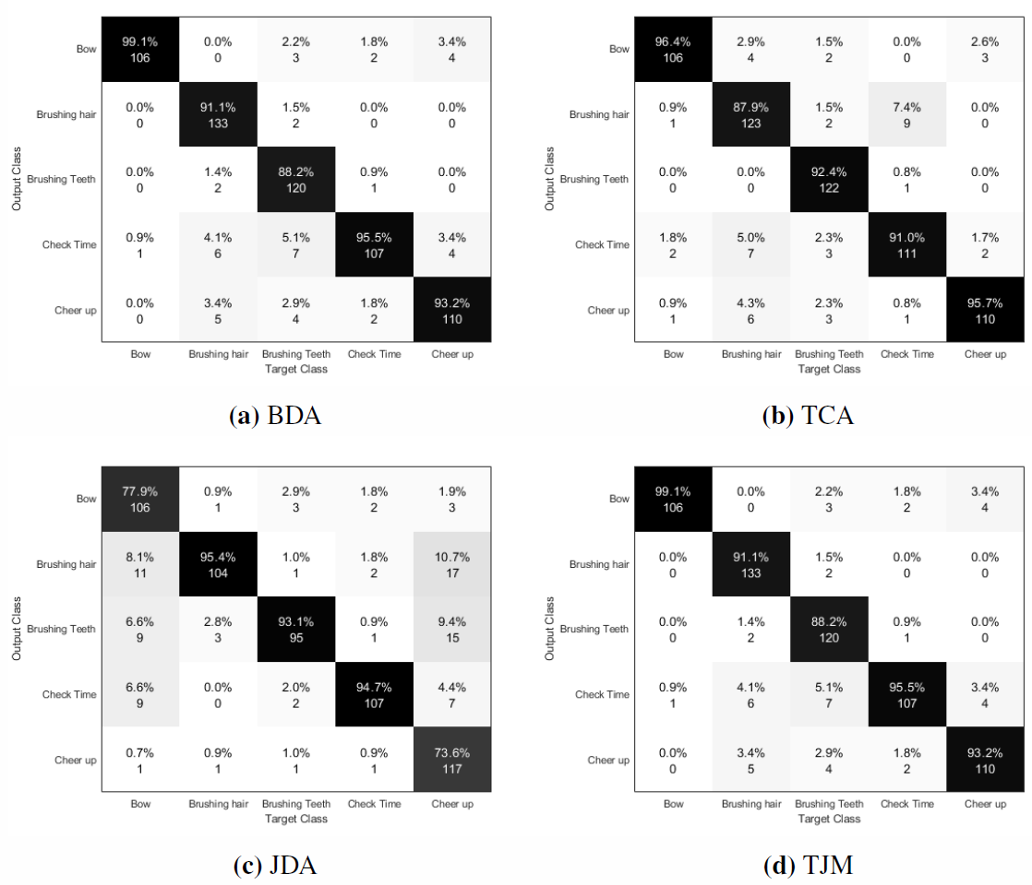
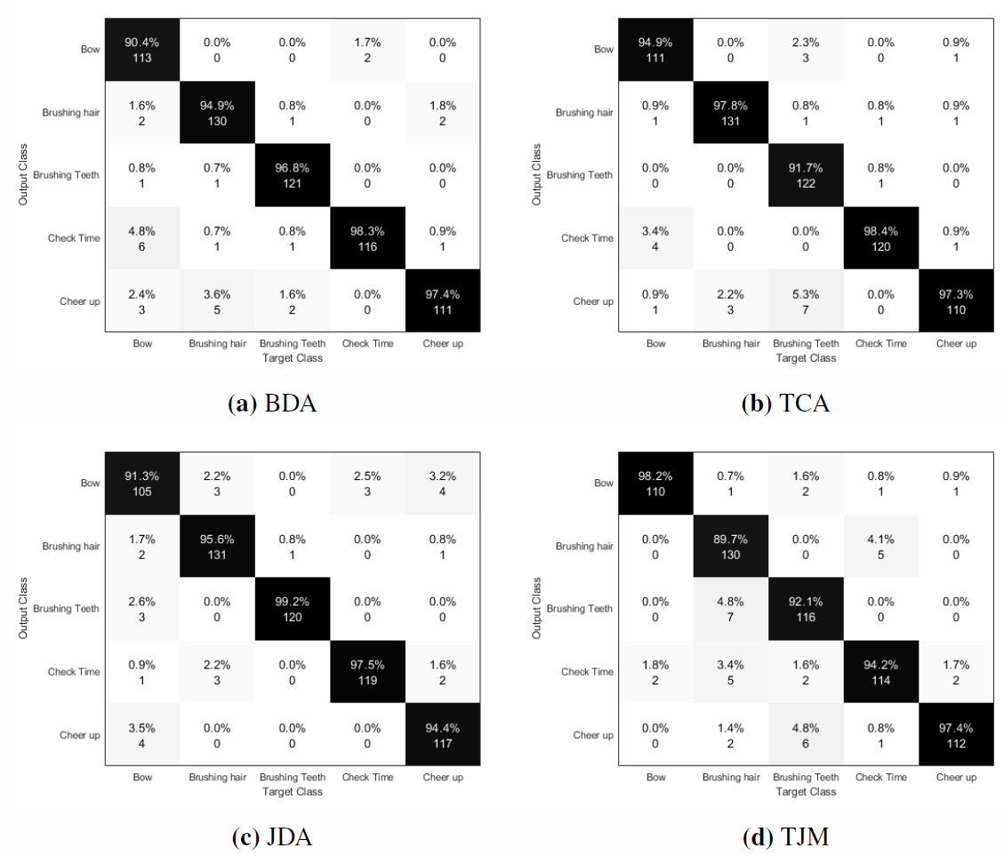
Cross-View Action Recognition via Joint Dictionary and Transfer Learning
View1- View2
View1- View3
View2- View3

Slide 26
Conclusions
Learned common feature space based on generic transfer learning
Learned shared view independent dictionaries
The joint learning paradigm demonstrated with appealing performance
Future work
Deep action representation: Two-stream Modeling, Trajectory-Pooled Deep-Convolutional Descriptors, etc.
Unknow testing categories: Zero Shot Learning
Compensating missing data: GAN modeling

Slide 27
Thank you
http://deepak-rathi.com/
http://chetan-kumar.com

